Slide 1


Valentin
Korzyuk

Slide 2

Outline
Executive Summary
Introduction
Methodology
Results
Conclusion
Appendix

Slide 3
Executive Summary
Summary of methodologies
Data about Falcon 9 launches was acquired from public sources – SpaceX data site and Wikipedia;
Research was performed primarily with Python libraries for data acquisition, wrangling, visualization and modelling
Correlations between various parameters (time, site, orbit, payload) and landing success were studied, 4 models were built and tested;
Summary of all results
Models built show predictive accuracy for landings outcome between 83 and 95 percent, which rather high. The highest score produced Decision Tree model;
There are major correlations between:
time (failures become rarer),
orbit (launches to low orbits have higher landing success rate),
payload (high-loaded launches are more successful in landings, though it may derive from orbits correlation)

Slide 4

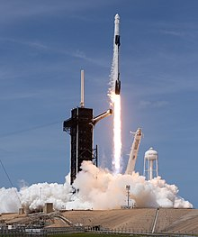
Introduction
Falcon 9 is a partially re-useable, medium lift launch vehicle that can carry cargo and humans into Earth orbit, even reaching the International Space Station (ISS) . It is produced by American aerospace company SpaceX. The rocket has two stages. The first (booster) stage carries the second stage and payload to a certain altitude, after which the second stage lifts the payload to its ultimate destination. The rocket evolved through several versions. V1.0 flew from 2010–2013, V1.1 flew from 2013–2016, while V1.2 Full Thrust first launched in 2015, encompassing the Block 5 Full Thrust variant, flying since May 2018.
The booster is capable of landing vertically to facilitate reuse.
Space X advertises Falcon 9 rocket launches on its website with a cost of 62 million dollars; other providers cost upward of 165 million dollars each, much of the savings is because Space X can reuse the first stage.
Therefore if we can determine if the first stage will land, we can determine the cost of a launch. This information can be used if an alternate company wants to bid against space X for a rocket launch.

Slide 5

Section 1

Slide 6
Methodology
Executive Summary
Data collection methodology:
SpaceX API
Public data from Wikipedia
Perform data wrangling
Deal with missing values
Reclassify landings results into either “success” or “failure” and determine rate of successful landings
Perform exploratory data analysis (EDA) using visualization and SQL
Perform interactive visual analytics using Folium and Plotly Dash
Perform predictive analysis using classification models
With Grid Search Method evaluate different models to find the best

Slide 7
Data Collection
Major data for the research was collected from open sources – site of SpaceX itself and Wikipedia, additional resources such as Wikipedia and NASA site were used for clarification of abbreviations and terminology.
Details are provided on further slides

Slide 8
Data Collection – SpaceX API
Extensive data about SpaceX launches available in json format through API interface from spacexdata.com site - https://docs.spacexdata.com/
Parsed data was converted into DataFrame format, processed (removed redundant columns and information about out-of-scope launches, missing payload information was substituted with mean value), and saved into csv-file
notebook for reference: spaceX_data_collection_api.ipynb at main · KoVal177/DS-IBM-10-Capstone (github.com)
Get raw json data from site
Convert json to pandas DataFrame
Filter data, remove redundancies
Deal with NaN
Save processed data into csv file

Slide 9
Data Collection - Scraping
Article in Wikipedia about Falcon launches contains information about every launch and its result:
List of Falcon 9 and Falcon Heavy launches - Wikipedia
The information is presented in table form, html format. Therefore, after downloading the page it was parsed with BeautifulSoup package – table → rows → cells
notebook for reference: spaceX_data_collection_webscraping.ipynb at main · KoVal177/DS-IBM-10-Capstone (github.com)
Load Wikipedia page
Create BeautifulSoup object
Find all tables
Parse table with launches information
Save extracted date to csv file

Slide 10
Data Wrangling
Patterns
Launches by site
Categorization
Landing outcome
Launches by orbit
Acquired data was processed with Pandas library
To determine initial patterns following values were calculated:
number of launches by site;
number of occurrence of each orbit;
number of different landing outcomes;
To enable further analysis landing outcomes were categorized into 0 (failure) and 1 (success) values
notebook for reference: spaceX_data_wrangling.ipynb at main · KoVal177/DS-IBM-10-Capstone (github.com)

Slide 11
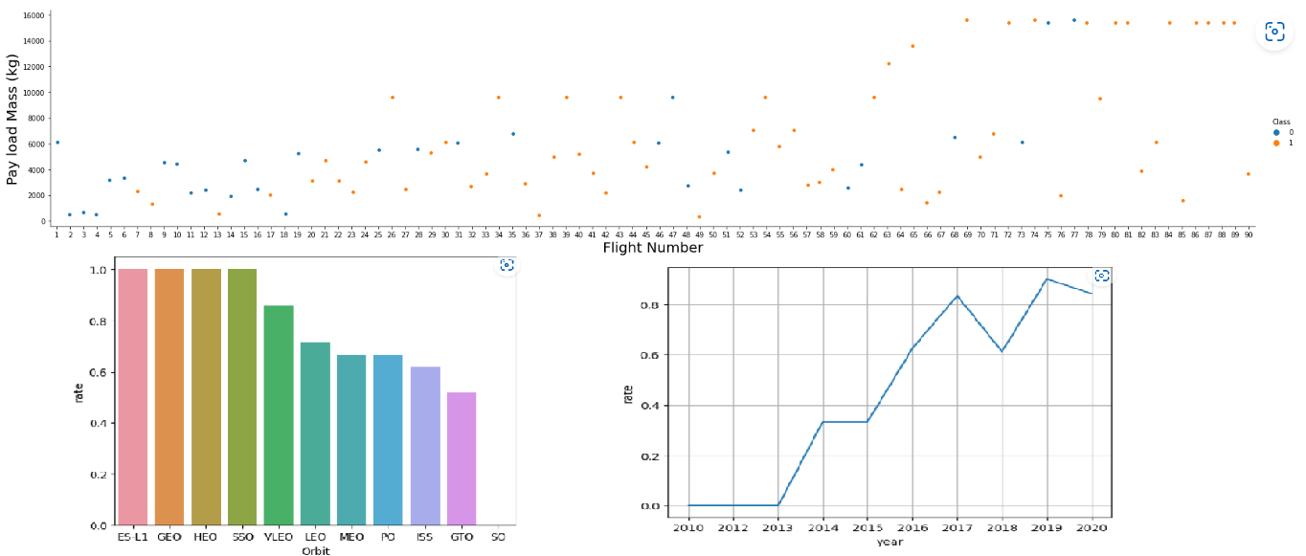
EDA with Data Visualization
Graphs built mostly concentrated on issues:
How successful landing rate changed over time;
How successful landing rate changed with payload;
Also landings were plotted against following categories:
launch site;
orbit;
To see three parameters at once scatter plots with color coding were used, for simpler relationship – bar and line charts
notebook for reference: spaceX_data_visualisation.ipynb at main · KoVal177/DS-IBM-10-Capstone (github.com)

Slide 12
EDA with SQL
Following SQL queries were performed to extract and study data:
Launch sites selection;
Filtering of data by:
launch site;
customer;
booster version;
Information about:
date of 1st successful landing at ground pad;
boosters with which landing success was reached;
total number of successful and unsuccessful missions;
etc.
List of successful landings by time period;
notebook for reference: spaceX_data_sql_sqlite.ipynb at main · KoVal177/DS-IBM-10-Capstone (github.com)

Slide 13
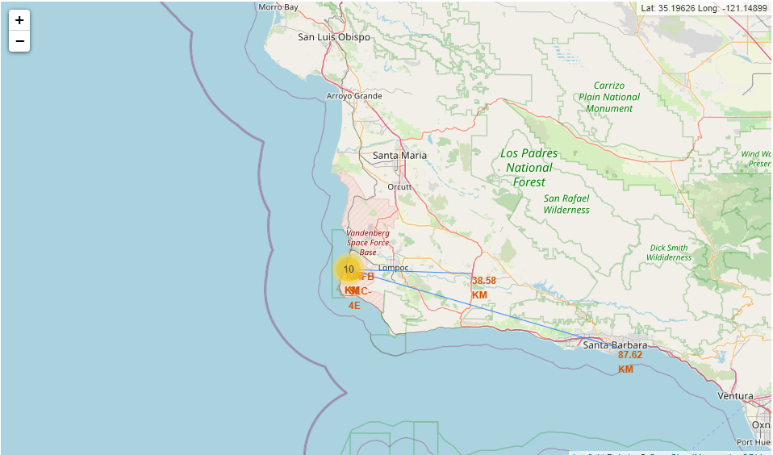
Build an Interactive Map with Folium
Information about launch sites was acquired and mapped
Following objects were created:
Circles to map site locations;
Markers for site locations and landings outcomes by site location (grouped into clusters)
Lines to highlight distance to closest infrastructure objects – coastline, railways, highways, cities
notebook for reference: spaceX_data_map_locations.ipynb at main · KoVal177/DS-IBM-10-Capstone (github.com)

Slide 14
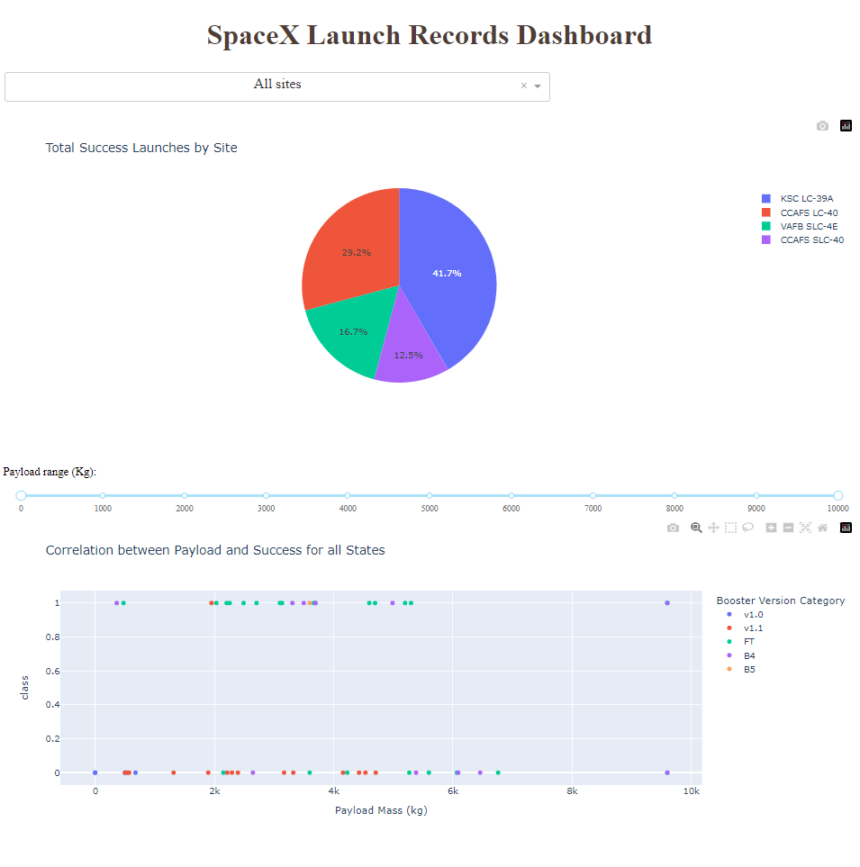
Build a Dashboard with Plotly Dash
Interactive dashboard was build to conveniently visualize relations between landing outcomes and:
Launch sites;
Booster versions;
Payload mass (with additional filtering by payload mass)
Instruments employed:
Pie chart (outcome by launch site);
Slider (for payload mass filtering)
Scatter plot (relation between payload and outcome with additional color coding of booster type)
Python code for reference: spacex_dash_app.py at main · KoVal177/DS-IBM-10-Capstone (github.com)

Slide 15
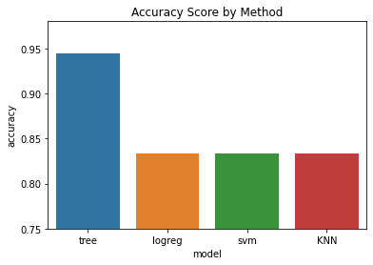
Predictive Analysis (Classification)
For predictive modelling methods of Machine Learning were employed.
Steps:
convert categorical data into numeric format;
rescale data;
divide data into training and testing sets;
by employing Grid Search Method (with cross-validation) four models were tested to find best model and set of hyperparemeters
identify the best model
Python code for reference:
spaceX_data_ML.ipynb at main · KoVal177/DS-IBM-10-Capstone (github.com)

Slide 16

Section 2

Slide 17
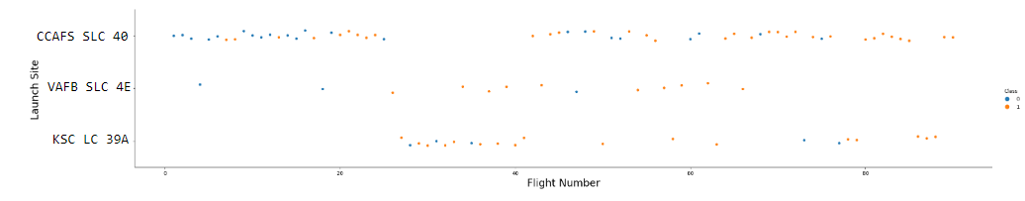
Flight Number vs. Launch Site
It is a clear difference between a number of successful landings and a launch site, with CCAFS SLC 40 falling behind, though it can be explained by time – most of earlier launches were done there. As number of launches increases share of successful landings increases as well.
Also the graph shows that CCAFS SLC 40 is a preferable site for launches (though for some time most activities were transferred to KSC LC 39A). It may also mean that most of experimental features would be first implemented here thus contributing to higher rate of failures.

Slide 18
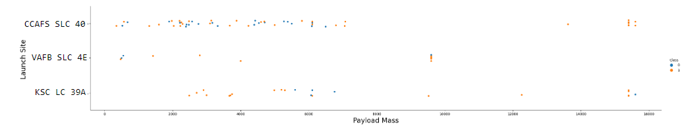
Payload vs. Launch Site
Most of launches are done with payload of below 10 ths. kg, at site VAFB SLC - all of them. Also, almost all of launches with high and medium payload (above 7 ths.) demonstrate notoriously high rate of success in landings with only few failures.

Slide 19
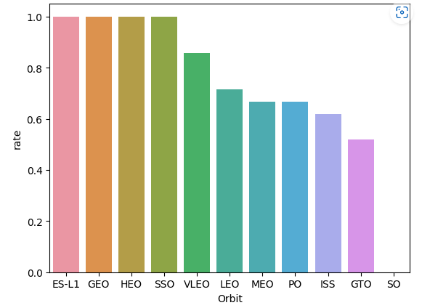
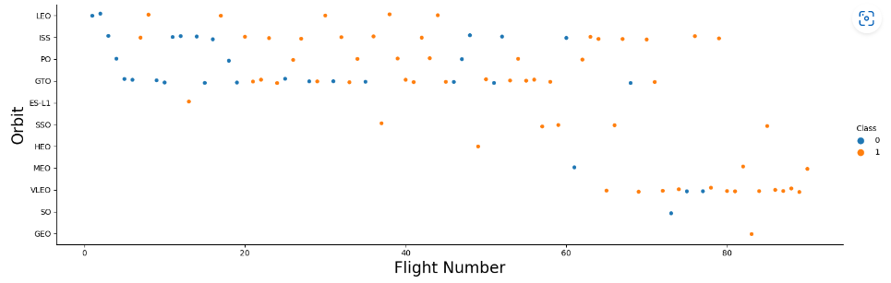
Success Rate vs. Orbit Type
Launches to GTO orbit are clear underdogs with lowest success rate (among orbits with at least 3 missions) with visually small gain over time. This a high geosynchronous orbit located at 22,236 km above Erth. Contrary to it, low-distance orbits (VLEO, ISS, LEO) show much better results.

Slide 20
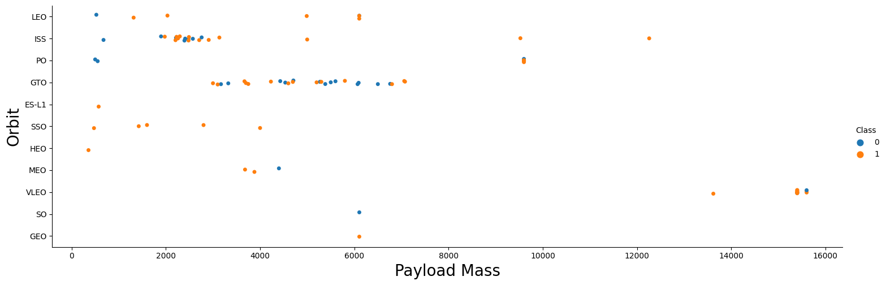
Payload vs. Orbit Type
All of the medium and high payload launches happen to low-Earth orbits (VLEO, ISS, PO), with high success rate. Lower payloads can be observed both at geosynchronous orbits and low-Earth orbits, generally, with significantly lower rate of successful landings.

Slide 21
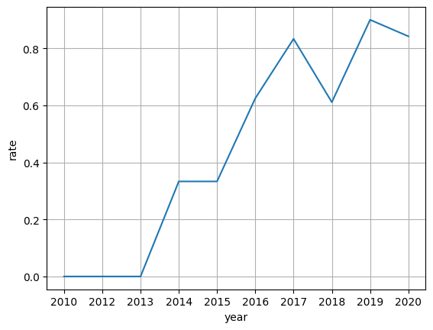
Launch Success Yearly Trend
Overall success rate of landings increases as time passes with experience and expertise obtained.

Slide 22
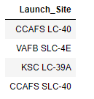
All Launch Site Names
Though 4 sites are present in initial database, actually all launches were performed from 3 sites – CCAFS LC-40 was renamed into CCAFS SLC-40 and means “Cape Canaveral Space Launch Complex”, Florida. Nearby located KSC LC-39A which i.e. “Kennedy Space Center Launch Complex”.
VAFB SLC-4E is in California and the full name is “Vandenberg Space Launch Complex”.

Slide 23
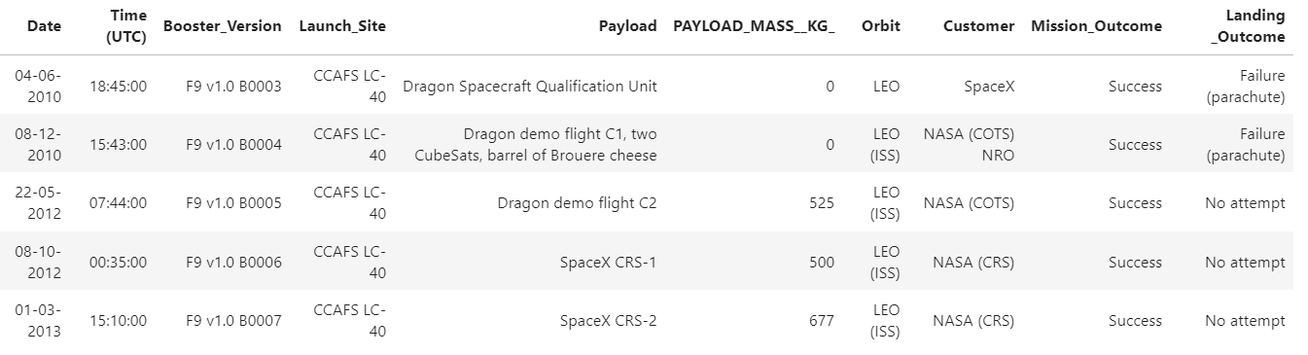
Launch Site Names Begin with 'CCA'
This table shows first 5 records where launch sites begin with `CCA`. That is how data is present in database.

Slide 24
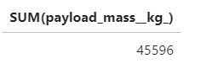
Total Payload Mass (NASA)
A total payload of 45.6 t was launched with NASA as customer.

Slide 25
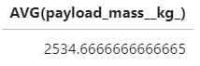
Average Payload Mass by F9 v1.1
Average payload mass launched with booster F9 v1.1 was 2535 kg, not very much

Slide 26
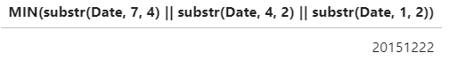
First Successful Ground Landing Date
First successful ground landing was performed at the 22-12-215*.
* - irregular format of output is due to sqlite engine features

Slide 27
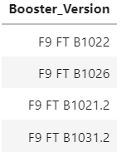
Successful Drone Ship Landing with Payload between 4000 and 6000
Successful drone ship landings were done with 4 different boosters for payload between 4000 and 6000 kg

Slide 28
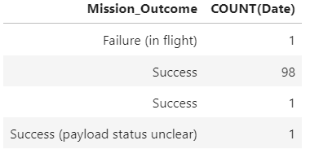
Total Number of Successful and Failure Mission Outcomes
In terms of mission outcomes all the launches except one were successful

Slide 29
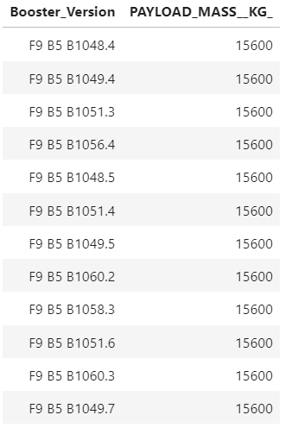
Boosters Carried Maximum Payload
In total 12 versions of boosters were used to carry maximum payload of 15.6 ton

Slide 30
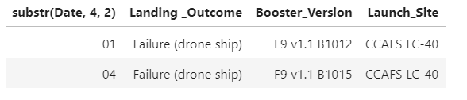
2015 Launch Records
There were 2 failures to land with drone ship in 2015

Slide 31
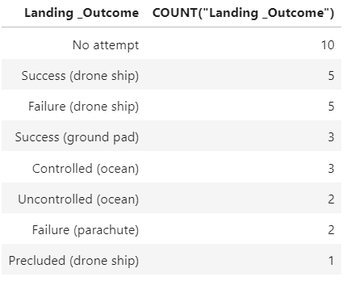
Rank Landing Outcomes Between 2010-06-04 and 2017-03-20
Between 2010-06-04 and 2017-03-20 a total of 31 launches were done, 2/3 of them – with landing attempt. The success rate was not very great at that time.

Slide 32

Section 3

Slide 33
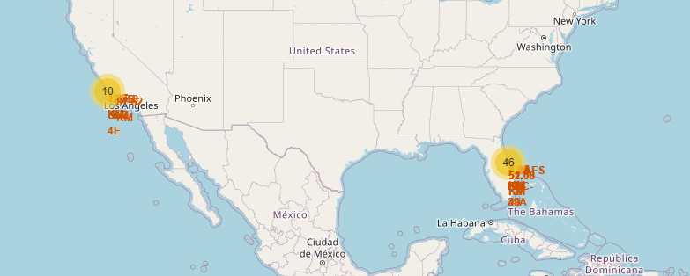
Launch Site Locations
Launches were performed from 2 clusters: 10 launches in California, 46 in Florida

Slide 34
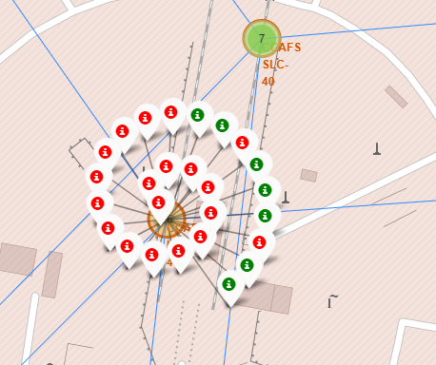
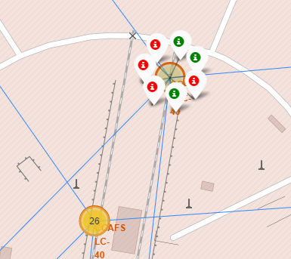
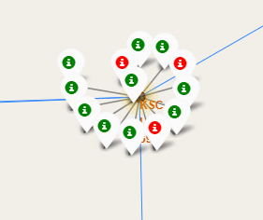
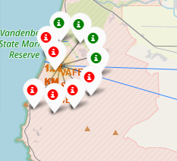
Launches by cluster
CCAFS LC-40 CCAFS SLC-40 KSC LC-39A VAFB SLC-4E
Information about individual launches (landing success/failure) can be obtained by pressing on the cluster circles. KSC LC-39A obviously has the highest success rate, VAFB SLC-4E – least popular

Slide 35
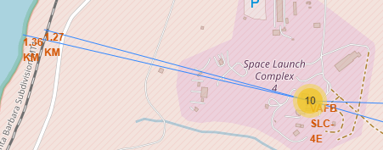
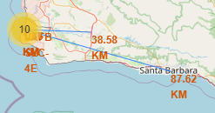
Vandenberg Space Launch Complex Infrastructure
The complex is in close proximity with coastline and railway, but highways and more or less populous cities are rather far

Slide 36
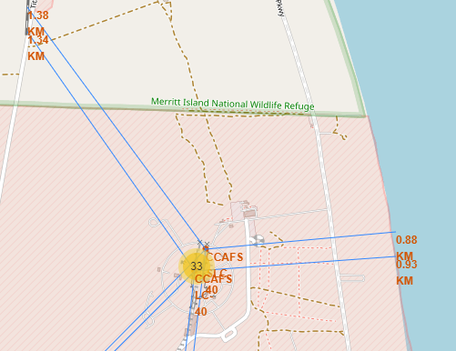
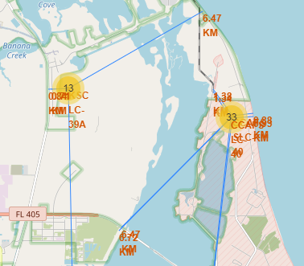
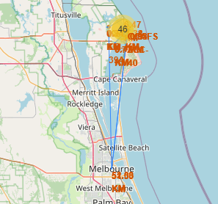
Cape Canaveral Cluster
Florida facilities are much stronger in terms of infrastructure, with railway, coastline, highways available “around a corner”. Only cities are a little bit far, but still closer, than in California

Slide 37

Section 4

Slide 38
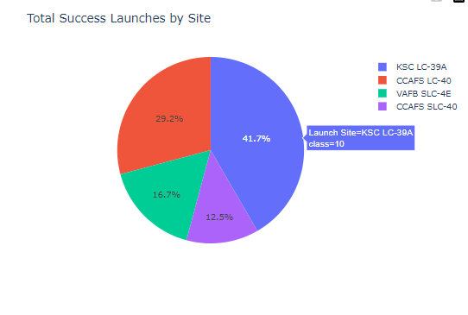
Launches with Successful Landings by Site
The chart shows share of each site in total number of successful landings. High share of KSC LC site is somewhat of surprise as this facility was not used very heavily. CCAFS SLC’s (LC-40 and SLC-40 – actually one and the same facility) share is more or less the same with VAFB SLC quite far behind.

Slide 39
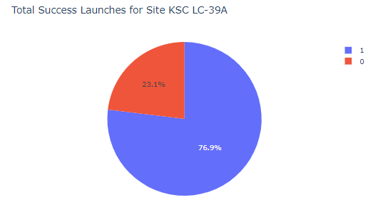
Landings Outcome at KSC LC site
KSC LC has the highest share of successful landings - 77%. That is why it has such a high share in total successful landings as noted on slide before

Slide 40
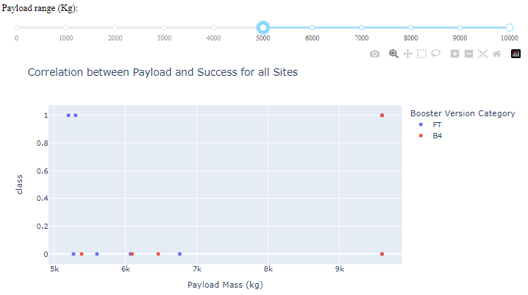
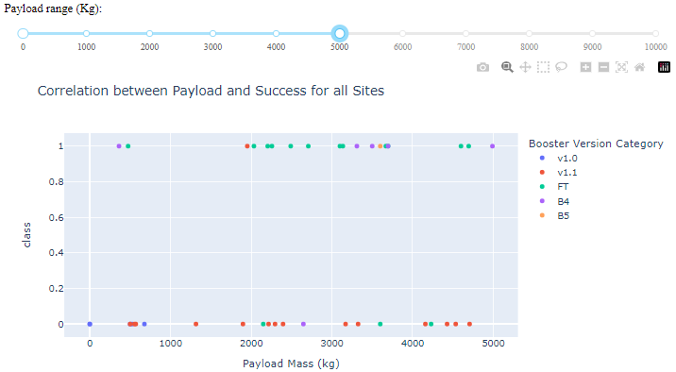
Success by Booster and Payload
Only 2 booster versions were used for launches with payload above 5 ths. kg, below this limit variation is much higher. Except for B5 (success) all other booster show mixed results, with most problematic payload at 5.5 – 9.5 ths. kg.

Slide 41

Section 5

Slide 42
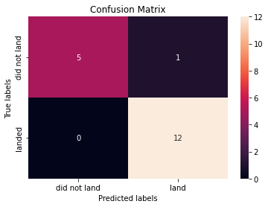
Classification Accuracy
Decision Tree method produced best results on test data with score of 0.94. It should be chosen as preferred one.
Confusion matrix for the method show, that it was able to correctly predict 17 out of 18 outcomes on test data (12 of 13 successful landings and 5 of 5 failures)

Slide 43
Conclusions
Accuracy score of 94% can be considered as very high. Though other models produced rather high results of 83%.
Confusion matrices for different models show, that models are better in predicting failures (all the values in 1st quadrant) and somewhat worse in dealing with successful landings.

Slide 44


